Slide 1
RESTAURANT FOOD ORDERING SYSTEM
ARANYA SINGH CHAUHAN : RA1911028010008
PRANIT TANDON : RA1911028010014

Slide 2
Design State , Collaboration, Deployment Diagram, Sample Frontend Design (UI/UX)

Slide 3
Architecture Diagram
An architectural diagram is a diagram of a system that is used to abstract the overall outline of the software system and the relationships, constraints, and boundaries between components. It is an important tool as it provides an overall view of the physical deployment of the software system and its evolution roadmap.

Slide 4
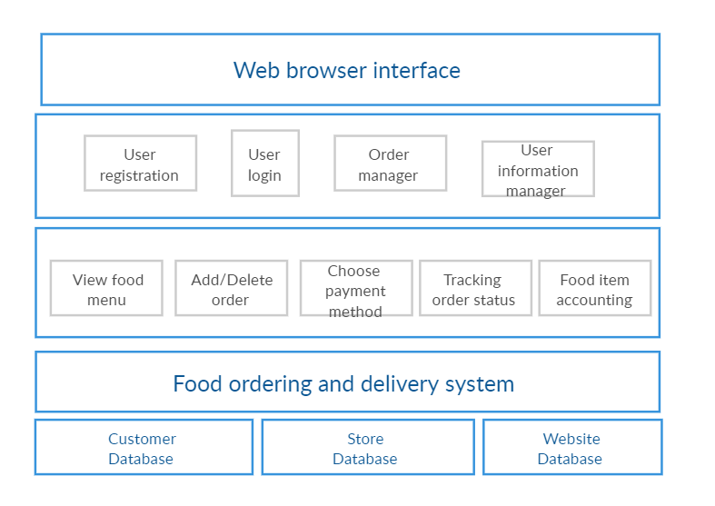

Slide 5
Collaboration Diagram
The collaboration diagram is used to show the relationship between the objects in a system. Both the sequence and the collaboration diagrams represent the same information but differently. Instead of showing the flow of messages, it depicts the architecture of the object residing in the system as it is based on object-oriented programming.

Slide 6
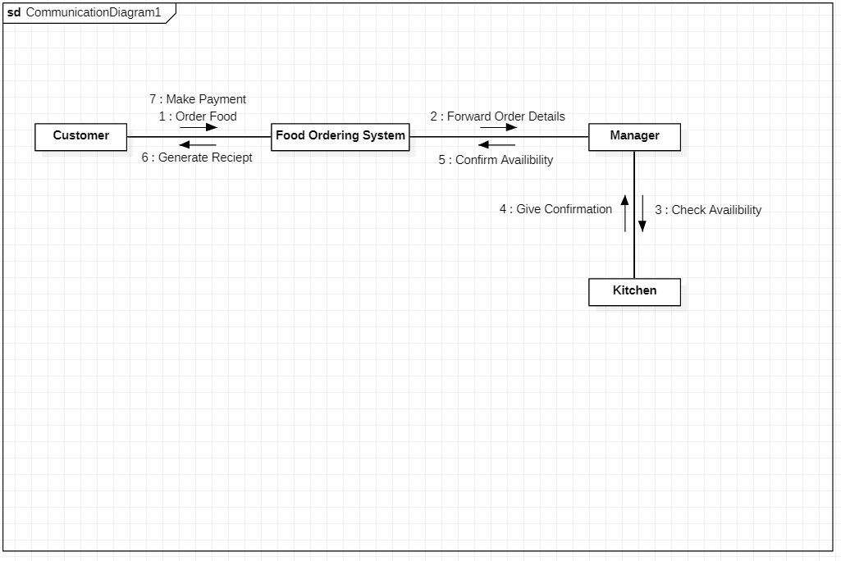

Slide 7
Deployment Diagram
A deployment diagram is a UML diagram type that shows the execution architecture of a system, including nodes such as hardware or software execution environments, and the middleware connecting them. Deployment diagrams are typically used to visualize the physical hardware and software of a system.

Slide 8
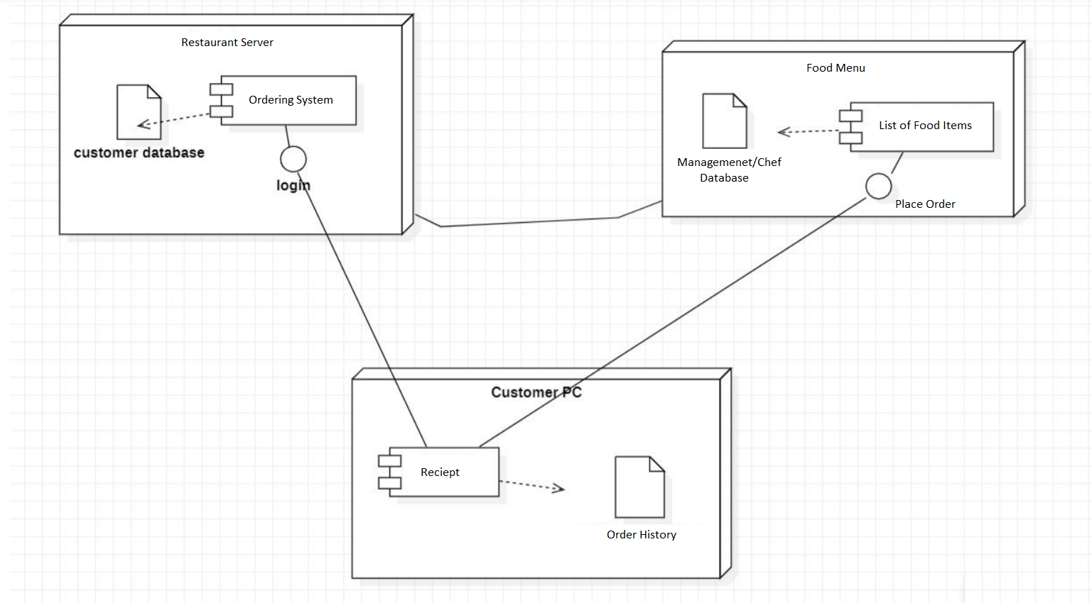

Slide 9
State Diagram
Statechart diagram is one of the five UML diagrams used to model the dynamic nature of a system. They define different states of an object during its lifetime and these states are changed by events. Statechart diagrams are useful to model the reactive systems. It describes the flow of control from one state to another state. States are defined as a condition in which an object exists and it changes when some event is triggered.

Slide 10
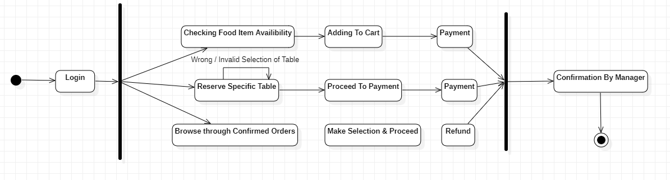

Slide 11
UI Sample:

Slide 12


Slide 13
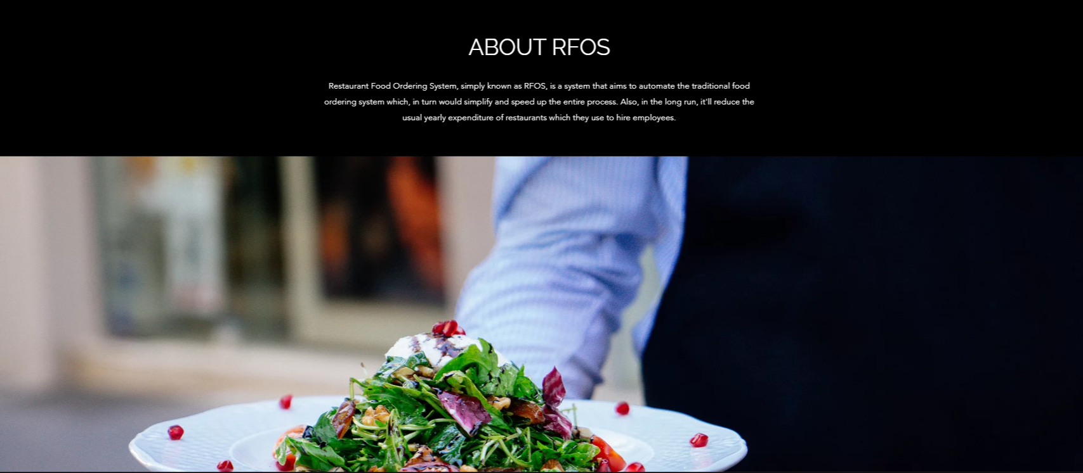

Slide 14
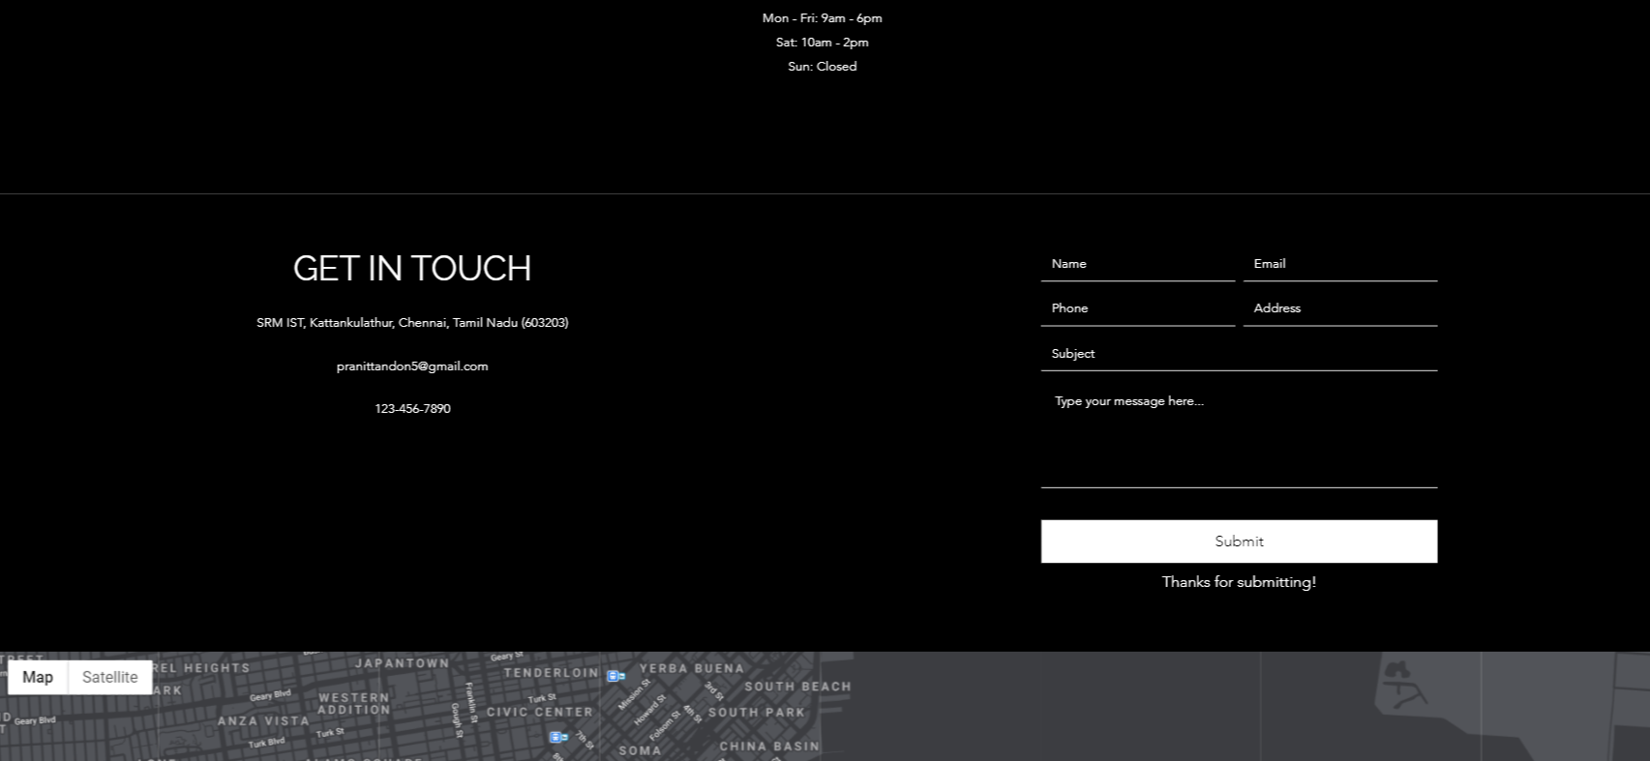

Slide 15
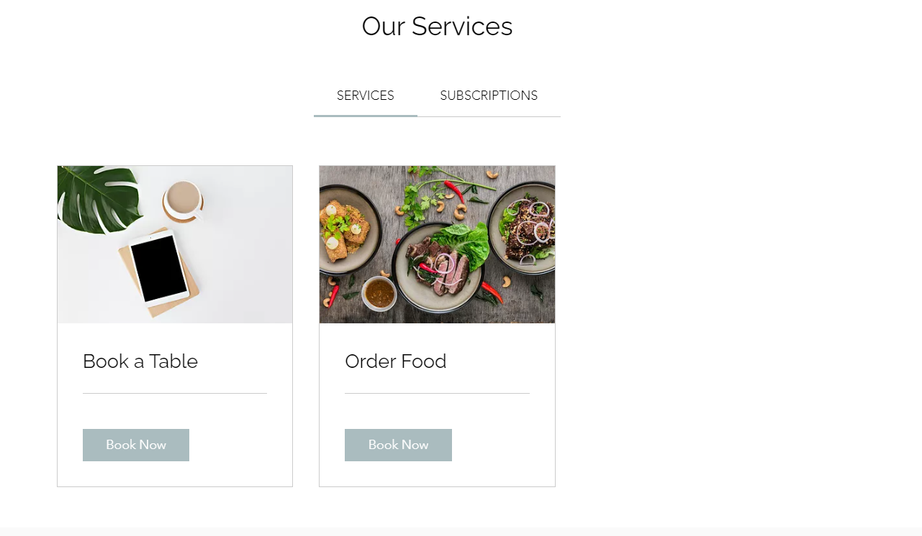

Slide 16
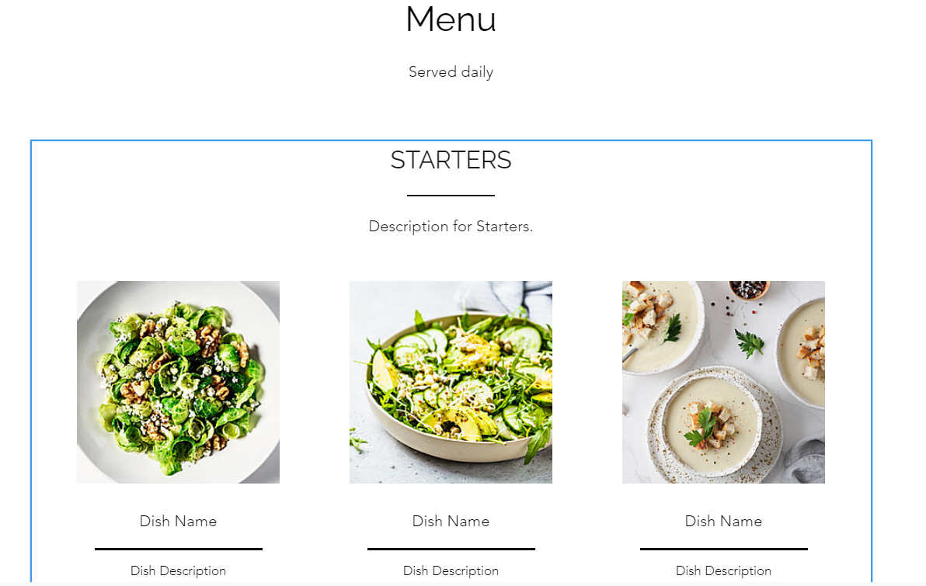

Slide 17
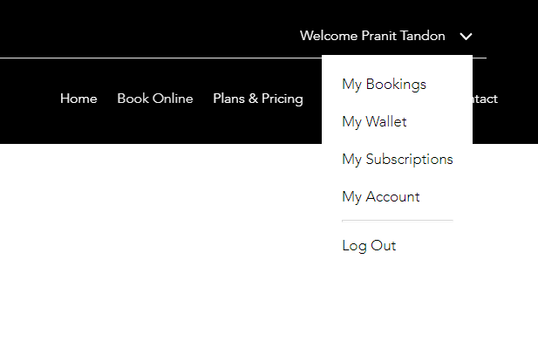

Slide 18
THANK YOU

